Slide 1


Slide 2

Introduction to
Data Science
(IT4142E)

Slide 3
Contents
Lecture 1: Overview of Data Science
Lecture 2: Data crawling and preprocessing
Lecture 3: Data cleaning and integration
Lecture 4: Exploratory data analysis
Lecture 5: Data visualization
Lecture 6: Multivariate data visualization
Lecture 7: Machine learning
Lecture 8: Big data analysis
Lecture 9: Capstone Project guidance
Lecture 10+11: Text, image, graph analysis
Lecture 12: Evaluation of analysis results

Slide 4
Course Information
Web page: https://users.soict.hust.edu.vn/hieunk/
Lecturer: Nguyen Kiem Hieu
Email: hieunk@soict.hust.edu.vn
Office: 1002 B1

Slide 5
NLP Introduction
Intro to NLP
POS tagging – HMMs

Slide 6
Intro to NLP
What is NLP?
Main tasks in NLP
Main challenges in NLP

Slide 7


Intro to NLP What is NLP?
Natural languages are used for communication between human and human, human and machine
Format: speech, text, image
Categorization: natural languages, programming languages

Slide 8
Intro to NLP What is NLP?
Undertanding, modeling natural languages
Human – machine communication using natural languages
Human – human communication using natural languages
Text mining for automation and decision making

Slide 9
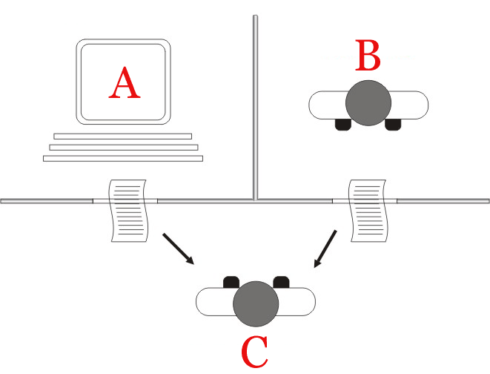
Intro to NLP What is NLP?
1950: Turing test

Slide 10
Intro to NLP What is NLP?
NLP is related to:
Linguistics, psychology, philosophy
Artificial intelligence, machine learning, big data

Slide 11
Intro to NLP Main tasks in NLP
INFORMATION EXTRACTION
NLP
APPLICATIONS
NATURAL LANGUAGE UNDERSTANDING
NATURAL LANGUAGE GENERATION
DATA + LINGUISTICS + MACHINE LEARNING

Slide 12
Intro to NLP Main tasks in NLP Natural language understanding
Word segmentation
“xử_lý ngôn_ngữ tự_nhiên”
(process language natural)

Slide 13

Intro to NLP Main tasks in NLP Natural language understanding
Part-of-speech tagging
DT
NN
VBD
IN
DT
NN
The
cat
sat
on
the
mat

Slide 14
Intro to NLP Main tasks in NLP Natural language understanding
Phrase chunking
[The cat]_{NP} [sat]_{VP} [on]_{PP} [the mat]_{NP}

Slide 15
Intro to NLP Main tasks in NLP Natural language understanding
S
Constitutent parsing
NP VP
PP
NP
DT NN VBD IN DT NN
The cat sat on the mat

Slide 16
Intro to NLP Main tasks in NLP Natural language understanding
Dependency parsing
nsubj
nmod:on
case
det
det
The
cat
sat
on
the
mat

Slide 17
Intro to NLP Main tasks in NLP Natural language understanding
S (sat)
NP (cat) VP (sat)
PP (on)
NP (mat)
DT NN VB IN DT NN
The cat sat on the mat

Slide 18
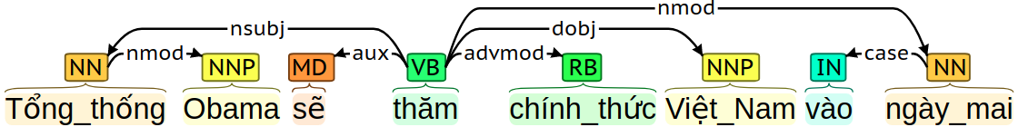
Intro to NLP Main tasks in NLP Natural language understanding

Slide 19
Intro to NLP Main tasks in NLP Natural language understanding
Co-reference resolution
doc#1
Alexis Sanchez stepped up his preparations for Manchester United’s FA Cup clash against Yeovil when he checked in for training on Thursday. The Chile star is in line to make his debut for the Red Devils in the fourth round tie at Huish Park following his move to Old Trafford. Sanchez met his new team-mates for the first time on Wednesday and could go straight into the matchday squad to face the Glovers. Jose Mourinho has so far given no indication on the strength of team that he will take to Somerset, but Sanchez will be keen to make his debut.
doc#2
Alexis Sanchez checks in for training as he prepares for his Manchester United debut

Slide 20

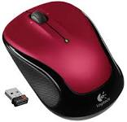
Intro to NLP Main tasks in NLP Natural language understanding
Semantic parsing
“Mouse love Rice”
“The history of computer mouse”

Slide 21

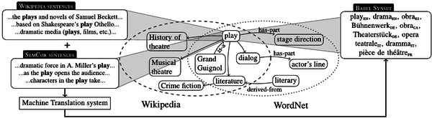
Intro to NLP Main tasks in NLP Natural language understanding
Multilingual concept net

Slide 22
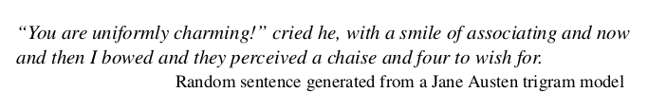
Intro to NLP Main tasks in NLP Natural language generation
Language models
`
From Dan Jurafsky 2018

Slide 23
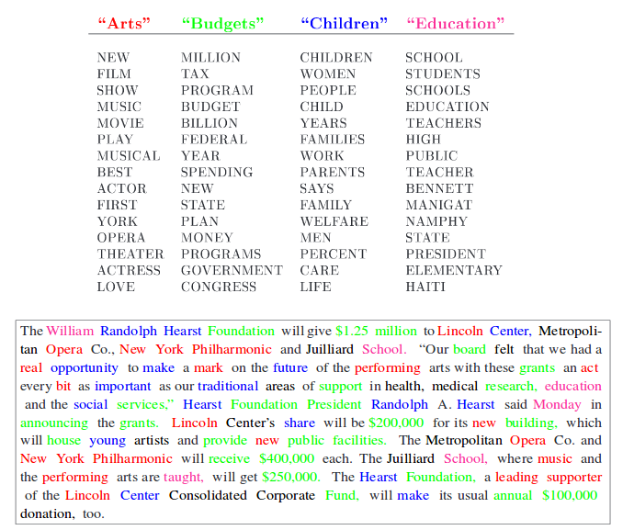
Intro to NLP Main tasks in NLP Natural language generation

Slide 24
Intro to NLP Main tasks in NLP Information extraction
Named entity recognition
[GM]_{ORG} sold the company in [Nov 1998]_{TIME} to [LLC]_{ORG}

Slide 25
Intro to NLP Main tasks in NLP Information extraction
Event extraction
trigger
attribute
GM sold the company in Nov 1998 to LLC
participants

Slide 26



Intro to NLP Main tasks in NLP Information extraction
Entity linking
Alexis Sanchez stepped up his preparations for Manchester United’s FA Cup clash against Yeovil when he checked in for training on Thursday. The Chile star is in line to make his debut for the Red Devils in the fourth round tie at Huish Park following his move to Old Trafford. Sanchez met his new team-mates for the first time on Wednesday and could go straight into the matchday squad to face the Glovers. Jose Mourinho has so far given no indication on the strength of team that he will take to Somerset, but Sanchez will be keen to make his debut.

Slide 27
Intro to NLP Main tasks in NLP NLP applications
Machine translation
Question answering
Dialog systems
...

Slide 28
Intro to NLP Challenges in NLP
Languages are ambiguous
Languages are diverse and dynamic
Pattern recognition is not enough
Annotated data are scared

Slide 29

Thank you for​ your attentions!​

